Slide 1
An Introduction
to eXp Realty
Canada Presentation

Slide 2
What We Will Cover
Who We Are
Our Business Model
Compensation
Cloud-based
Community
Join the team that’s
breaking down boundaries
Notes:
Can we align bullets

Slide 3
Founder
Glenn Sanford had important roles at internet startups before launching a real estate career in 2002.
In his fourth year in real estate with a major national franchisor, his team closed more than $60 million in real estate by connecting with consumers online.
Glenn believed that agents and brokers do the heavy lifting in real estate and deserve the benefits of being a shareholder and income based on their contributions.
In 2009, Glenn founded the first cloud-based brokerage — eXp Realty.

Slide 4
Who We Are
How We Made It to Today

Slide 5
2009 eXp Realty is founded | 2010 eXp celebrates 1-year anniversary, operates in 11 states | 2011 eXp recognized as Innovator by Inman | 2012 eXp Realty launches in Canada | 2013 eXp World Holdings goes public on OTCQB exchange | 2014 Founder and CEO Glenn Sanford included on 200 Most Powerful People in Real Estate by Swanepoel
2015
eXp launches Agent Equity
and ICON Agent programs
2017
eXp exceeds 6,000 agents; named to Glassdoor’s
Best Places to Work list
2016
eXp triples agent count
in a single year
2018
eXp World Holdings joins Nasdaq; eXp Realty open in all 50 states
2019 eXp turns 10, now exceeds 25,000 agents; Sanford named top CEO by Glassdoor | 2020 eXp Global has international footprint in 8 countries; eXp Commercial launches | 2021 eXp exceeds 67,000 agents Globally
Notes:
2017 - Canada relaunched

Slide 6
eXp Realty Core Values
Beliefs that shape our culture
Community
Service
Be a good neighbor to
create a sustainable legacy
Make positive change in our company and local community
Fun
Sustainability
Don’t take yourself too seriously
Be a good financial steward of the
environment, the organization and our families
Agile
Collaboration
Force chaos and change to survive and grow
We are all on the same team
Innovation
Transparency
The best way to predict the future is to invent it
Get things out from behind
the curtain
Integrity
Do the right thing

Slide 7
Our Business Model

Slide 8
Innovation Is Always Happening
eXp Realty is innovating in the real estate brokerage space
Brick & Mortar Locations | Anytime, Anywhere
Traditional real estate brokerages
*Trademarks pictured are the property of their respective owners

Slide 9
One Brokerage, Not a Franchise
eXp Realty is one international company changing the industry
Typical Franchise
Costly Overhead Franchise and Desk Fees Locally Confined Smaller Referral Network Inconsistent Growth Incentives Minimal Opportunities for Ownership Limited Technology & Support Few Tools and Support Resources | Powerful Equity Opportunities Revenue Share and Stock Equity Programs Cloud Campus Environment No Desk Fees, Work From Anywhere Real-time Support Specialized Support Teams Ready to Help Live Training 50+ Hours Weekly Online Training International Collaboration Expansive Referral Networks and Education

Slide 10
Cloud Campus Environment
No desk fees
Work from anywhere
Cut overhead brick-and-mortar costs
No expensive leases means the company can invest in agent support and technology
Paperless transactions
Get instant access to training and support

Slide 11
Agent-centric Value Proposition
eXp Realty: Most Agent-centric Company on the Planet
$
Compensation
Unique financial model with various opportunities to make and earn income.
No franchise fees
Generous commissions (80/20 split with $16K cap)
Revenue-share program for attracting agents to eXp
Equity awards for meeting production goals
Access to eXp Agent Healthcare options by Group Source
Community
Community means more than just a place to hang your license.
Cloud-based collaboration suite allows agents to connect, share and network
Company-wide diversity programs
ICON Achiever Program
Partner community with access to professional services, listing services, and client services
New Agent BootCamp program
Cloud-based
Anywhere, Anytime.
The first global brokerage to shift from brick-and-mortar to cloud-based
Work from anywhere using eXp’s state-of-art technology, a virtual campus with an immersive platform connecting all agents globally
Productivity suite with collaboration tools, co-working, CRM, lead share/lead gen, referral, and over 50+ hours of weekly live education and events
Our Mission: to give agents the best opportunity to succeed.
Notes:
Changed Compensation - last two words from Clearwater to “Group Source”.
Changed Community - Mentorship to “New Agent Bootcamp”

Slide 12
Compensation
Unique financial model with various opportunities to make and earn income.

Slide 13
No Desk Fees, Royalty Fees or Franchise Fees
Commission & Cap
80/20 commission split $16,000 cap After that earn 100% commission for the remainder of anniversary year.¹ ¹ $250 capped transaction fee. Once capped transaction fees total $5,000 then the capped transaction fee is reduced to $75.
Commission & Cap
80/20 commission split $16,000 cap After capping, earn 100% commission for the remainder of anniversary year.¹ ¹ $285 capped transaction fee. Once capped transaction fees total $5,700 then the capped transaction fee is reduced to $75.
Standard Costs (CDN)²
$199 start-up fee $139/month cloud brokerage fee $29 transaction review fee ³ $17 risk management fee ⁴ ² These are CDN fees only ³ Per transaction ⁴ Per month in applicable provinces.
Notes:
UPDATE:Cap transaction fee is 285 then reduced to 75 on achieving 5700
Start up 199
Monthly 139
Broker Review fee 29
Risk management 17 per month not per transaction *in applicable provinces

Slide 14
Revenue Share Plan
eXp’s revenue share plan is one way that eXp rewards its agents for attracting new agents to join eXp.
Simply, an eXp agent can “sponsor” a new agent to join eXp. Once the new agent begins closing on transactions, the sponsor receives a percentage of the company revenue from the sales activity of their sponsored agent until their annual commission cap of $16,000 is reached.
Important note: eXp pays that share — not the agent. It is taken from the 20% adjusted gross commission income (AGCI) received by eXp, and is paid to the sponsor agent monthly.
To learn more, visit eXp’s eXplore Guide: https://explore.exprealty.ca/.
Notes:
Corrected the CDN explore guide link

Slide 15
Single Agent
Revenue Share*
Tier 1
Up to $2,800
3.5% of the gross commission
Agents at eXp can receive revenue share income from the sales activity of agents they bring into the company.
For each person you bring into eXp you can earn up to $2,800 depending on the sales production of that person.
This continues to be paid to you as long as you remain an active agent and the agent you have brought into the business stays with eXp and generates sales requirements.
Revenue share is paid from the percentage that eXp receives and does not reduce agent commission.
*These figures are not a guarantee, representation or projection of earnings or profits you can or should expect. They also do not include expenses incurred by Agents in operating their businesses. eXp Realty makes no guarantee of financial success. Success with eXp Realty results only from successful sales efforts, which require hard work, diligence, skill, persistence, competence, and leadership. Your success will depend upon how well you exercise these qualities.

Slide 16
Cascading
Revenue Share
Tier 1 | Tier 2
Up to $2,800 | Up to $3,200
Earn more for BOTH the productive agents you bring into eXp Realty AS WELL as for the agents they bring in.
As an example: If you personally sponsor 5 agents to eXp who meet the production requirements, and they in turn sponsor their own productive agents, you can earn up to up to an additional $3,200 annually for the production of each of those Tier 2 agents, ON TOP of the $2,800 you earn from the agents that you have brought in.
*These figures are not a guarantee, representation or projection of earnings or profits you can or should expect. They also do not include expenses incurred by Agents in operating their businesses. eXp Realty makes no guarantee of financial success. Success with eXp Realty results only from successful sales efforts, which require hard work, diligence, skill, persistence, competence, and leadership. Your success will depend upon how well you exercise these qualities.

Slide 17
eXp Revenue Share Explained
Cascading Revenue Share
 | Maximum Potential Annual Revenue Share Per Agent | Personal Qualifying Agent Count Needed
Tier 1 | Up to $2,800 | 1+
Tier 2 | Up to $3,200 | 5+
Tier 3 | Up to $2,000 | 10+
Tier 4 | Up to $1,200 | 15+
Tier 5 | Up to $800 | 20+
Tier 6 | Up to $2,000 | 25+
Tier 7 | Up to $4,000 | 40+

Slide 18
Equity Opportunities
Agents can become shareholders at eXp Realty
Nasdaq: EXPI
Each year Earn shares on your first transaction
Earn shares when you cap
Earn shares when an agent you sponsor closes their first transaction
Sustainable Equity Plan
Up to $16,000 in stock upon the achievement of certain production and cultural goals within your anniversary year
ICON Agent
Award
Agent Equity
Program
Enroll to be paid 5% of every transaction commission with stock at a 10% discount

Slide 19
eXp Agent Healthcare
Flexible plan offers
Meeting the needs of Independent Contractors:
Flex plan style with 3 choices for coverage levels.
Each participant may select a plan that fits within their budget and desired coverage level.
All pre-existing conditions are covered immediately for Health and Dental Care with no medical information required.
Allows each participant to apply for additional Life and/or Critical Illness coverage if they desire.
Healthcare
consultants help you
get the best plan for the lowest cost.
Notes:
Needs the details of the Canadian agent healthcare program

Slide 20
Cloud-Based
Brokerage whose foundation is built using innovation and cutting-edge technology.

Slide 21
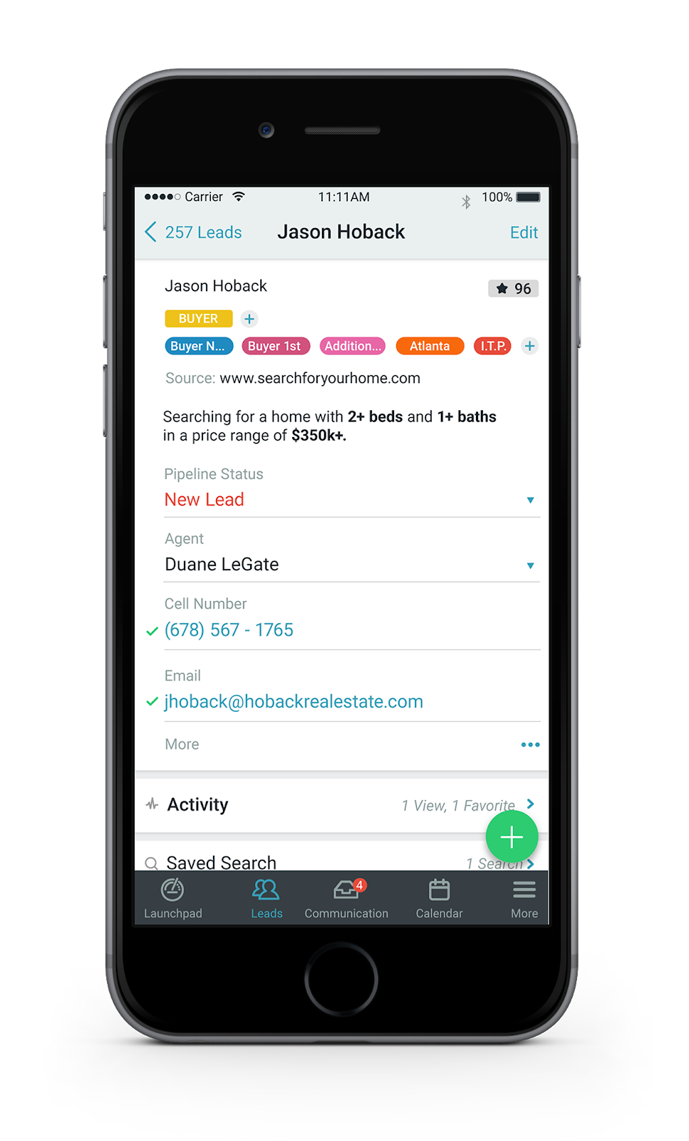
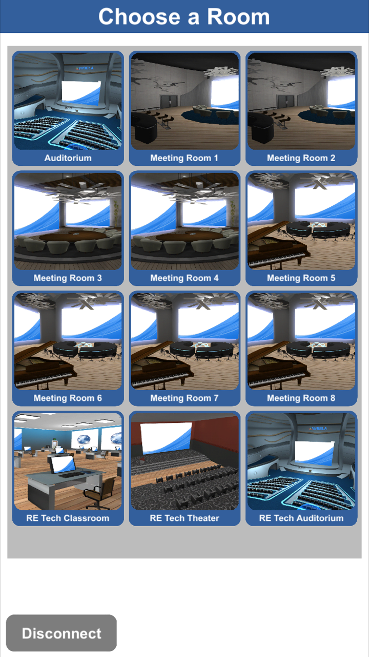
Welcome to Our World: Work Anywhere, Anytime
Join a meeting or learn on the go with eXp Realty agents everywhere.
Agents gain instant, live support from eXp’s agent services, technology and finance experts -- all from wherever an agent or team is located.

Slide 22
Cloud-Based Agent Tools
The best tools and services to grow a real estate business
eXp Enterprise Business Intelligence | Transaction Management | Community Platform
CRM & Lead Generation | Live Training | eXp’s Resource Guide

Slide 23
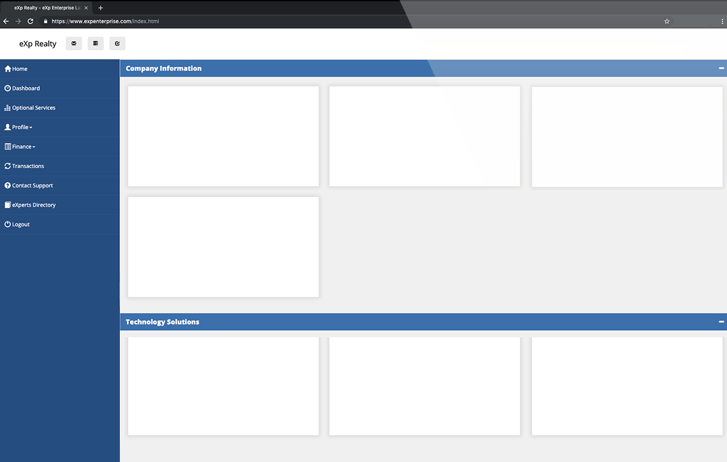
eXp Enterprise
eXp’s Enterprise dashboard gives agents autonomy and greater visibility into metrics and business intelligence that’s crucial to their needs.
exprealty.com
Investor Relations
Official Press Releases
View agent details
See commission and cap status
Review agent equity awards
Get real-time performance reports
exprealty.com
Skyslope Transaction Management
Lead generation, website, CRM
Making It Rain

Slide 24
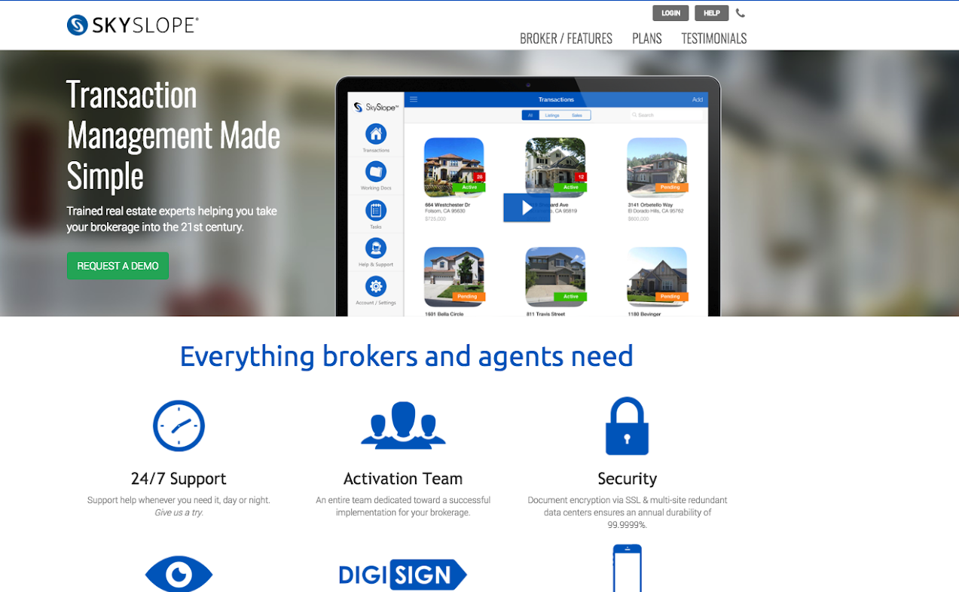
Transaction Management
eXp’s transaction management platform allows agents to manage their transactions from beginning to close — totally paperless.
Review transactions from any device
Sign documents digitally
Run your business with top-grade security features

Slide 25
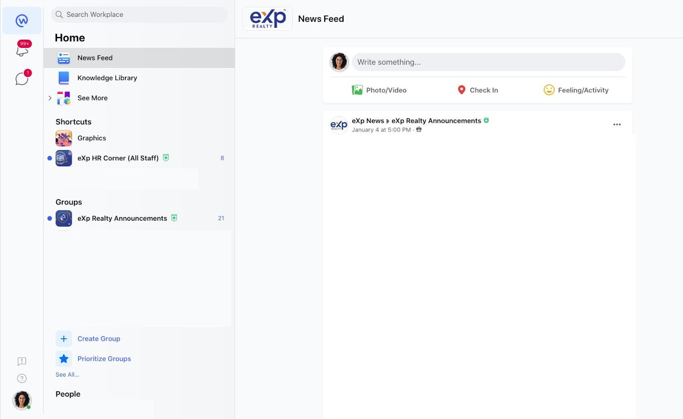
Community Platform
Workplace is an easy-to-use collaboration platform, a lot like Facebook, but built for the world of work.
Discuss topics and projects
Share announcements
Communicate instantly with your team and others across the company
Broadcast live video and view past recorded videos

Slide 26
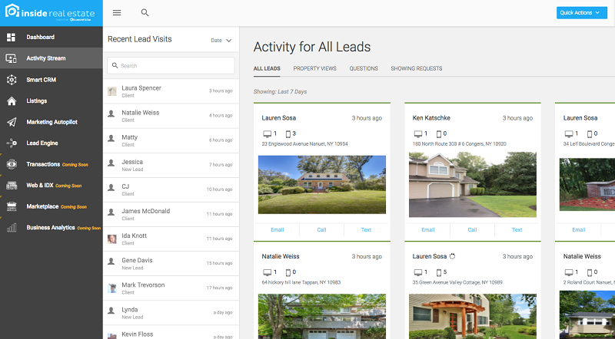
CRM & Lead Generation
Agents and teams use tools provided by eXp Realty daily to drive more leads and deals. Manage customer interactions and share property information.
Powerful lead generation platforms provided at no additional cost
Integrate listings with your own WordPress website
Optional in-house lead generation program

Slide 27
Live Training
More than 50 hours of live training each week
Learn from industry experts and top producers about:
Sales and listings
Lead generation
Social media
CRM and technology tools
Tap into an archive of recorded sessions

Slide 28
Community
eXp utilizes the collection of knowledge and experience of its members to create a real community based on helping each other earn, learn, grow.

Slide 29
eXp Celebrates Diversity
eXp Realty is proud of its commitment to diversity
and inclusion through its initiative, ONE eXp. This commitment supports eXp’s culture by embracing differences, promoting equality and mutual respect, and providing a space where everyone has a voice and the opportunity to succeed.
ONE eXp is committed to diversity and inclusion through:
Education: Host ONE eXp meetings to educate and increase awareness in this new diversity and inclusion initiative.
Coverage: Ensure diversity and inclusion is represented in marketing materials, press coverage and events.
Asian Network
Black eXp Network
eXp Latino
eXp Pride Network
eXp Power Girls
and more!

Slide 30
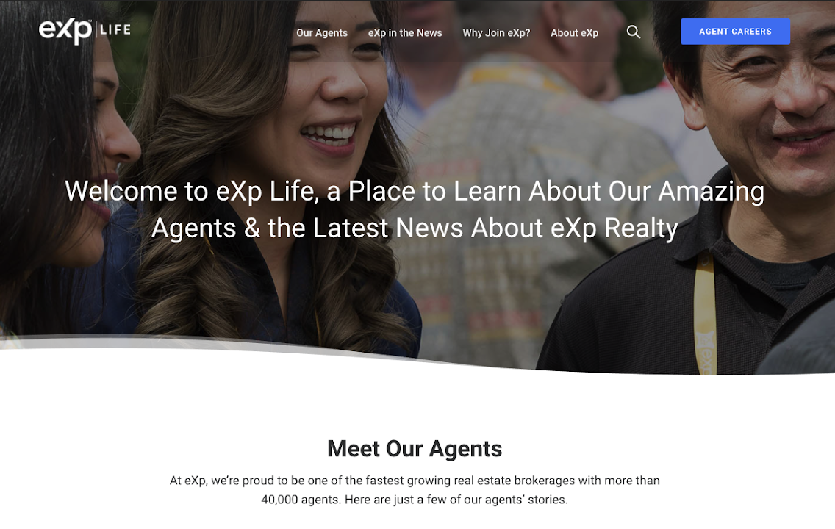
eXp Life
eXp Life is eXp’s popular online news magazine where we share stories about interesting eXp agents and post the
latest news about eXp World Holdings’ properties, including eXp Realty,
eXp Global, eXp Commercial,
SUCCESS Enterprises, Virbela and more.

Slide 31
International
Collaboration
Interact and learn from other top professionals in the company
Build teams across states and provinces with one nationwide cap
Host and participate in daily, live online gatherings
Benefit from a powerful referral network
Share best practices among peers

Slide 32
eXp Continues International Expansion!
Australia Brazil Canada France Hong Kong | India Italy Mexico Portugal | Puerto Rico South Africa UK United States
Notes:
If the provinces did not go on the ribbon mentioned above then possibly another slide with a map of Canada and the years the various provinces joined

Slide 33
Agent Voice in the Company
The CDN Agent Advisory Council (CAAC) is made up of nominated
and selected eXp Realty agents and brokers from a variety of production levels and locations.
The CAAC ensures that the voice of the agent is heard at the highest levels of the company. It benefits shareholders while providing new ways for our senior leadership to obtain additional insight as our company grows.
Notes:
Relabel “Canadian Agent Advisory Council"

Slide 34
Join the team that’s
breaking down boundaries.

Slide 35
Join the Company Everyone is Talking About
Team recruitment drives eXp’s strong agent growth in Q3.” |  | “eXp Realty Accelerates Its Already Significant Growth Throughout North America.” |  | “The Amazon Model of Zero Physical Infrastructure: Real Estate — You’re Next.”
“The Amazon of Real Estate.” |  | “eXp World Holdings: Attempting To Disrupt The Real Estate Brokerage Status Quo.” |  | “eXp is a real estate phenomenon poised for success in 2021 and beyond.”

Slide 36
Production Matters at eXp
eXp Realty is a top-ranked, residential real estate brokerage
#1 Top Independents Ranked by closed transaction sides for 2019 | #1 Top Movers: Transactions Ranked by largest increase in closed sides from 2018 to 2019 | #2 Sales Volume Increase Ranked by largest increase in percentage for closed sales volume from 2018 to 2019 | #5 Agent Count Ranked by 2019 agent count
#2 Top Movers: Volume Ranked by largest increase in closed sales volume from 2018 to 2019 | #3 Closed Transaction Sides Ranked by closed transaction sides for 2019 | #5 Transaction Sides Ranked by 2019 transaction sides | #7 Sales Volume Ranked by 2019 sales volume (ranked #13 in 2018)
#4 Closed Sales Volume Ranked by closed sales volume for 2019 | #4 The Billionaires’ Club Ranked by at least $1 billion of closed sales volume in 2019

Slide 37
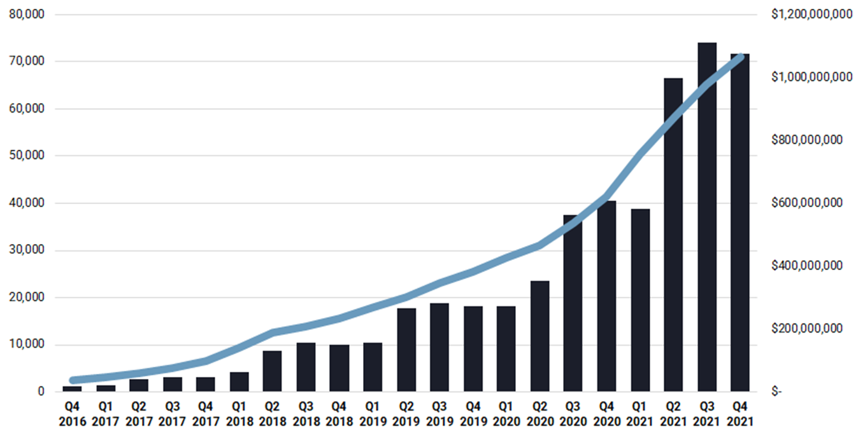
Phenomenal Agent and Revenue Growth
Elevated growth in both agent count and revenues as a result of our commitment to agents
eXp Realty Ending Agents and Revenue By Quarter
Revenues
Agent Count
Agent Growth YoY 72%
now 75K+ agents¹
Total 2021 Revenue $3.8B
AGENTS
REVENUES
Agent count as of February 23, 2022

Slide 38
Become an eXp Agent
Talk to your sponsor, or apply today at join.exprealty.com

